Slide 1
MAESTRO Workshop #4
Life Table Reconstruction
&
Multispecies Models
Sub project 4.2

Slide 2
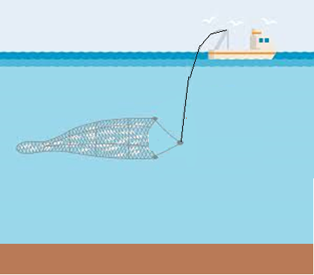


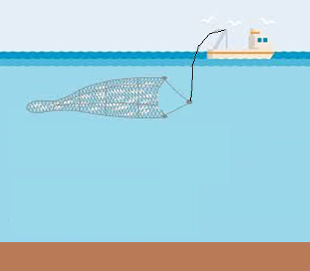



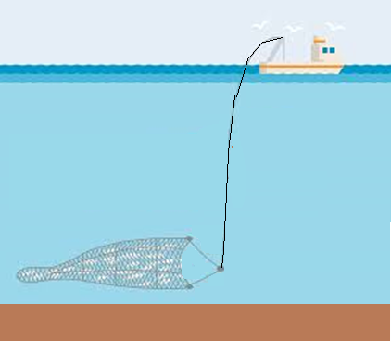
Task 4 Objectives
Explore the impact of varying catch strategies on the diversity of stocks within an ecosystem
How does redistributing catch across species impact functional diversity
Are their optimal harvesting strategies that can optimize functional diversity

Slide 3
Task 4 Objectives
Explore the impact of varying catch strategies on the diversity of stocks within an ecosystem
How does redistributing catch across species impact functional diversity
Are their optimal harvesting strategies that can optimize functional diversity
How might climate impacts influence these strategies

Slide 4
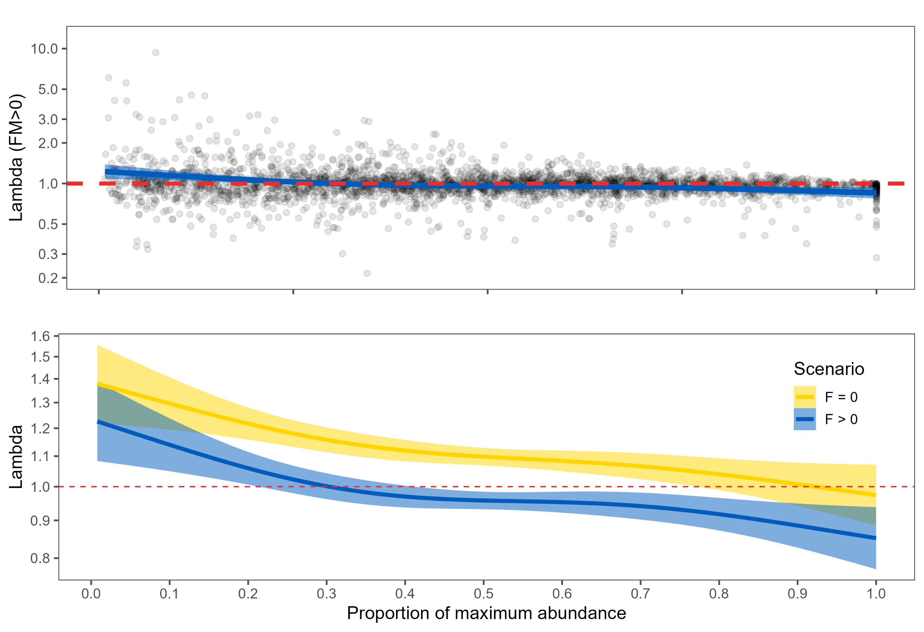
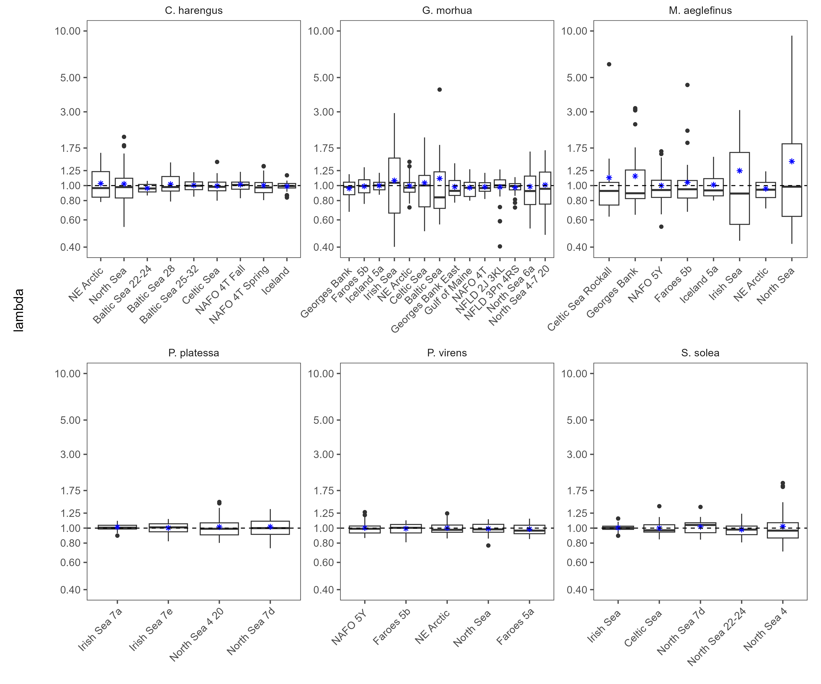
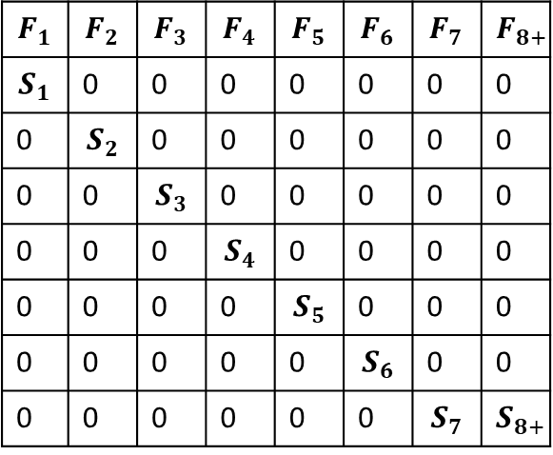
Life Table Reconstruction
Life Table Reconstruction
Enables us to use data from data rich stocks to parameterize our models
$$F_{1}$$ | $$F_{2}$$ | $$F_{3}$$ | $$F_{4}$$ | $$F_{5}$$ | $$F_{6}$$ | $$F_{7}$$ | $$F_{8+}$$
$$S_{1}$$ | 0 | 0 | 0 | 0 | 0 | 0 | 0
0 | $$S_{2}$$ | 0 | 0 | 0 | 0 | 0 | 0
0 | 0 | $$S_{3}$$ | 0 | 0 | 0 | 0 | 0
0 | 0 | 0 | $$S_{4}$$ | 0 | 0 | 0 | 0
0 | 0 | 0 | 0 | $$S_{5}$$ | 0 | 0 | 0
0 | 0 | 0 | 0 | 0 | $$S_{6}$$ | 0 | 0
0 | 0 | 0 | 0 | 0 | 0 | $$S_{7}$$ | $$S_{8+}$$
lambda

Slide 5
What is the LTR model
Developed for sharks
Used life history information and catch history to reconstruct population dynamics
Life history data included
Size
Longevity
Offspring production
A time series of removals by fisheries (all sources of removals)
An estimate of population size at one point in time

Slide 6
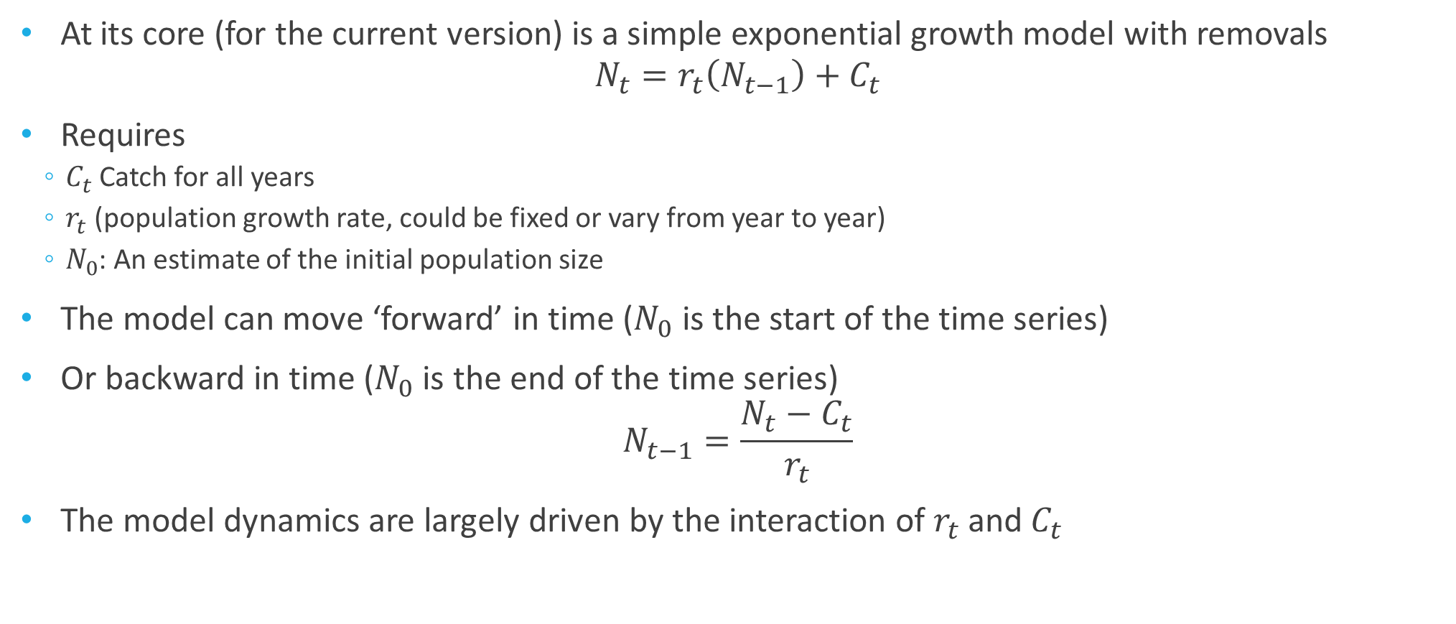
Under the Hood
At its core (for the current version) is a simple exponential growth model with removals
$$N_{t}=r_{t}\left(N_{t−1}\right)+C_{t}$$
Requires
$C_{t}$Catch for all years
$r_{t}$ (population growth rate, could be fixed or vary from year to year)
$N_{0}$: An estimate of the initial population size
The model can move ‘forward’ in time ($N_{0}$ is the start of the time series)
Or backward in time ($N_{0}$ is the end of the time series)
$$N_{t−1}=\frac{N_{t}−C_{t}}{r_{t}}$$
The model dynamics are largely driven by the interaction of $r_{t}$ and $C_{t}$

Slide 7
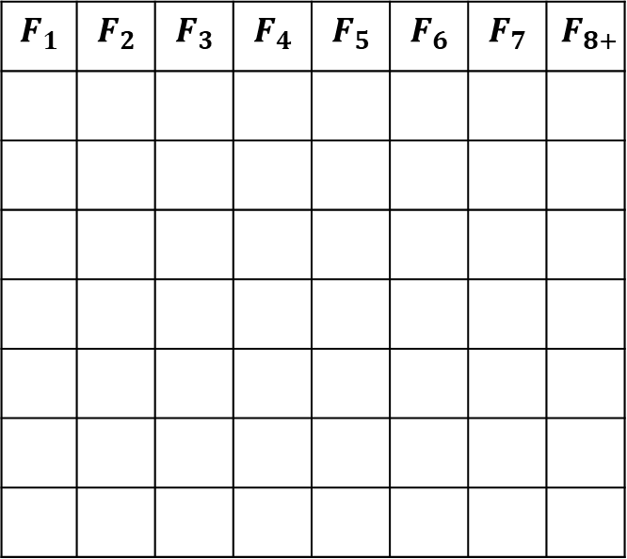
Decomposing $r_{t}$ ($N_{t}=r_{t}\left(N_{t−1}\right)+C_{t}$)
The rate of growth determines how quickly a population grows (or declines)
Driven by fecundity
$$F_{1}$$ | $$F_{2}$$ | $$F_{3}$$ | $$F_{4}$$ | $$F_{5}$$ | $$F_{6}$$ | $$F_{7}$$ | $$F_{8+}$$

Slide 8
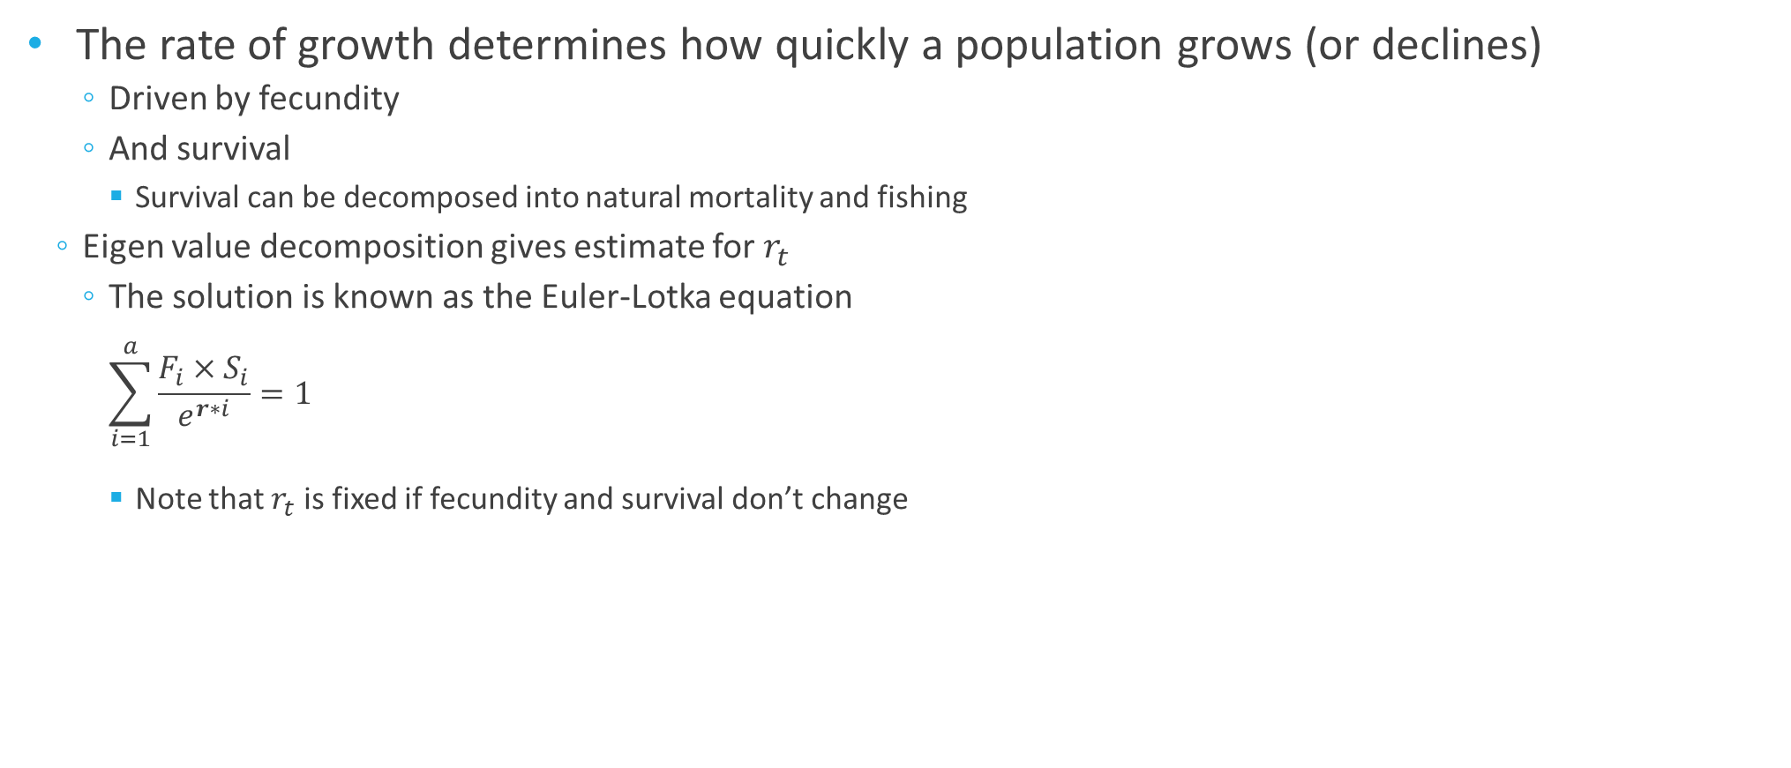
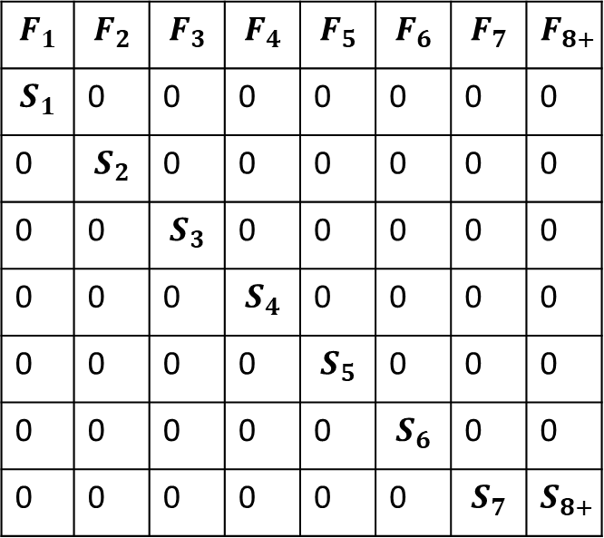
Decomposing $r_{t}$ ($N_{t}=r_{t}\left(N_{t−1}\right)+C_{t}$)
The rate of growth determines how quickly a population grows (or declines)
Driven by fecundity
And survival
Survival can be decomposed into natural mortality and fishing
Eigen value decomposition gives estimate for $r_{t}$
The solution is known as the Euler-Lotka equation
$$\sum_{i=1}^{a}{\frac{F_{i}×S_{i}}{e^{r∗i}}=1}$$
Note that $r_{t}$ is fixed if fecundity and survival don’t change
$$F_{1}$$ | $$F_{2}$$ | $$F_{3}$$ | $$F_{4}$$ | $$F_{5}$$ | $$F_{6}$$ | $$F_{7}$$ | $$F_{8+}$$
$$S_{1}$$ | 0 | 0 | 0 | 0 | 0 | 0 | 0
0 | $$S_{2}$$ | 0 | 0 | 0 | 0 | 0 | 0
0 | 0 | $$S_{3}$$ | 0 | 0 | 0 | 0 | 0
0 | 0 | 0 | $$S_{4}$$ | 0 | 0 | 0 | 0
0 | 0 | 0 | 0 | $$S_{5}$$ | 0 | 0 | 0
0 | 0 | 0 | 0 | 0 | $$S_{6}$$ | 0 | 0
0 | 0 | 0 | 0 | 0 | 0 | $$S_{7}$$ | $$S_{8+}$$

Slide 9
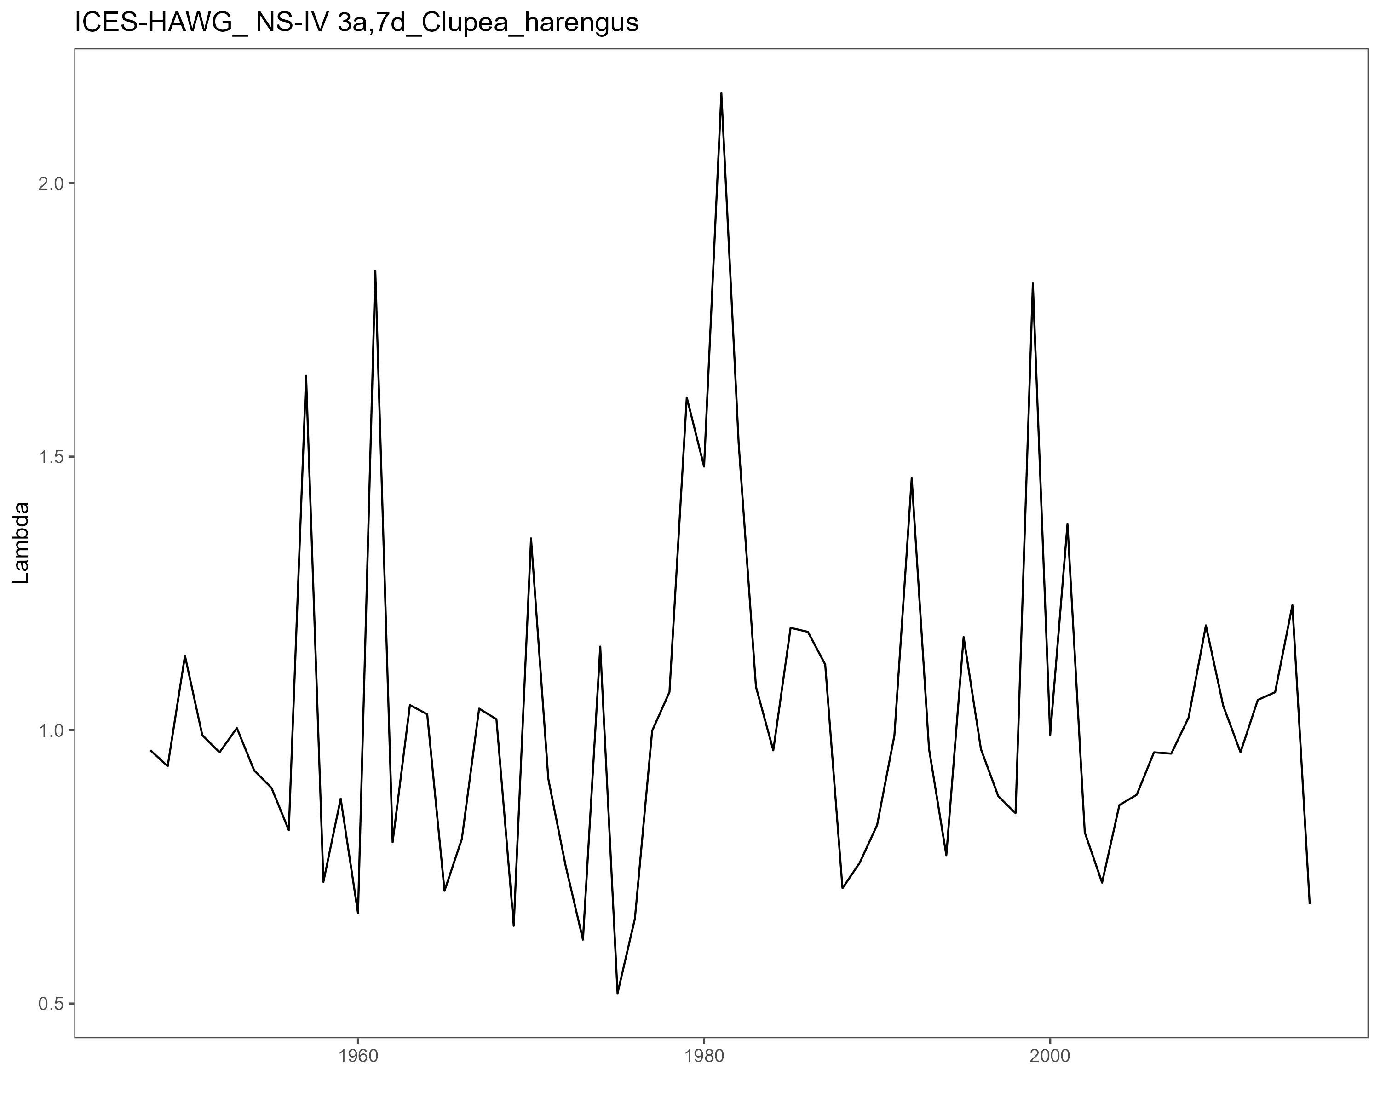
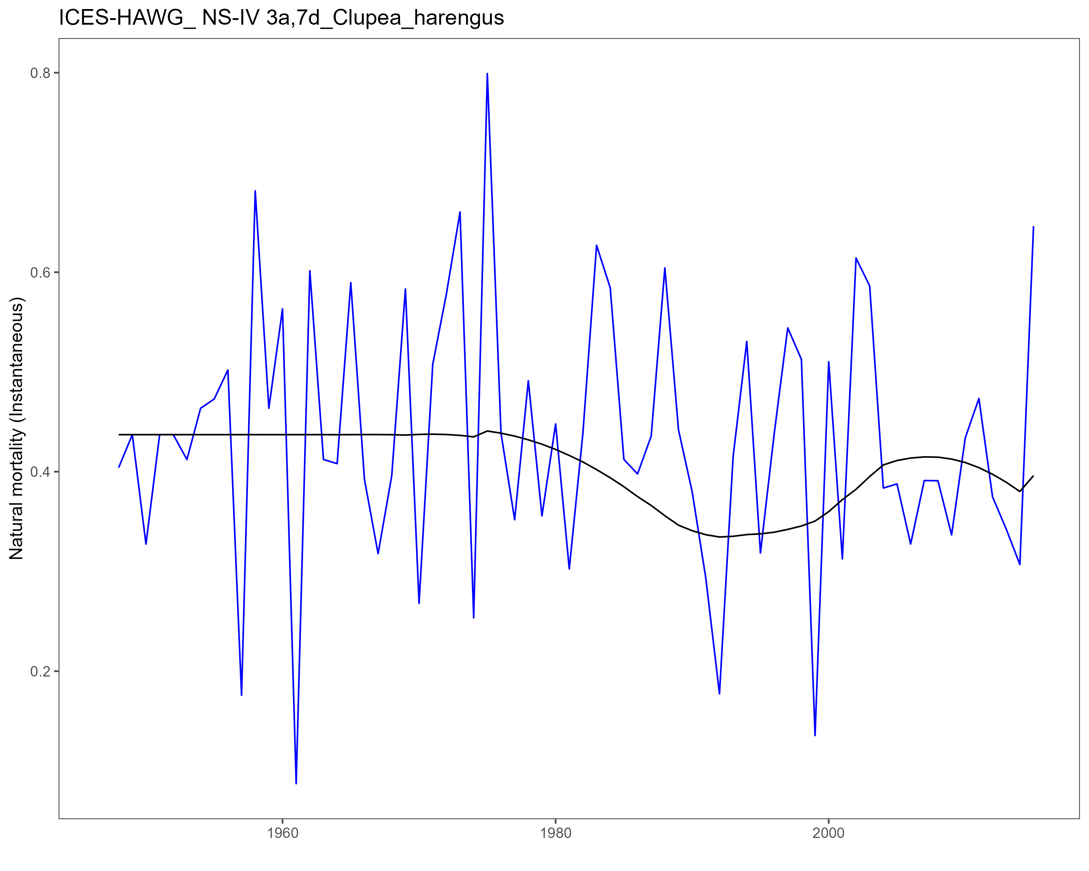
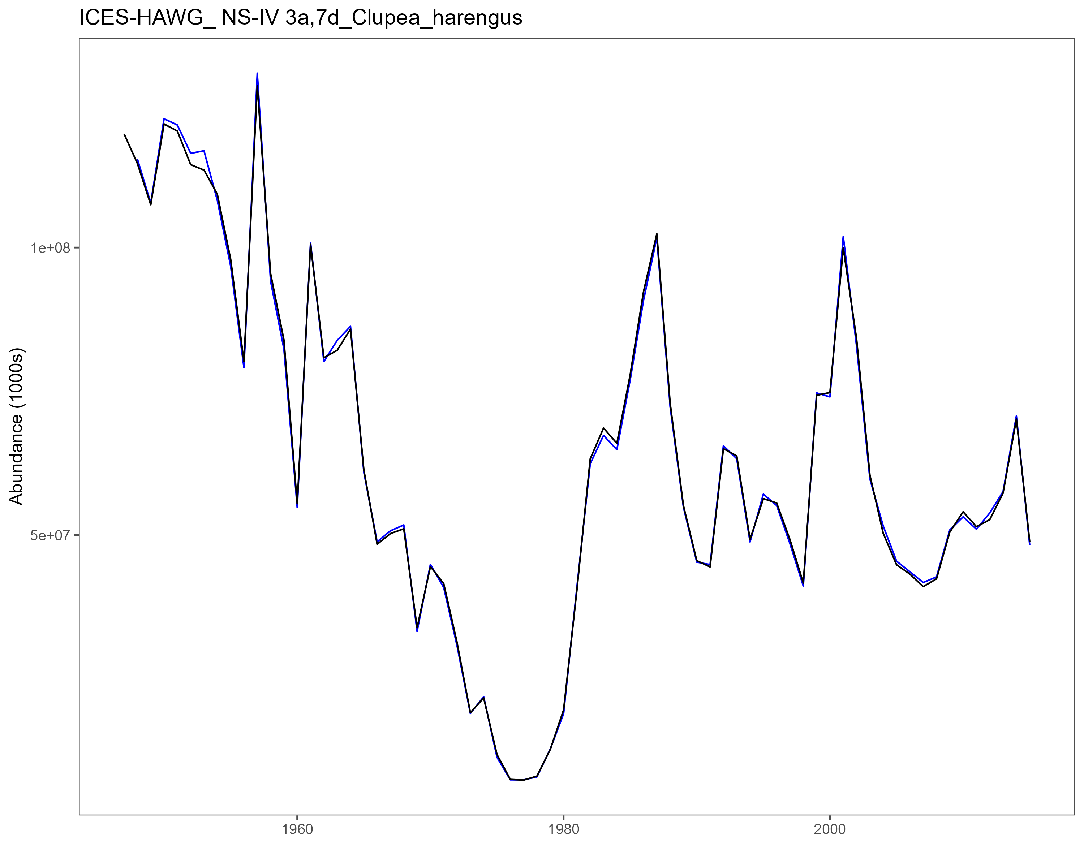
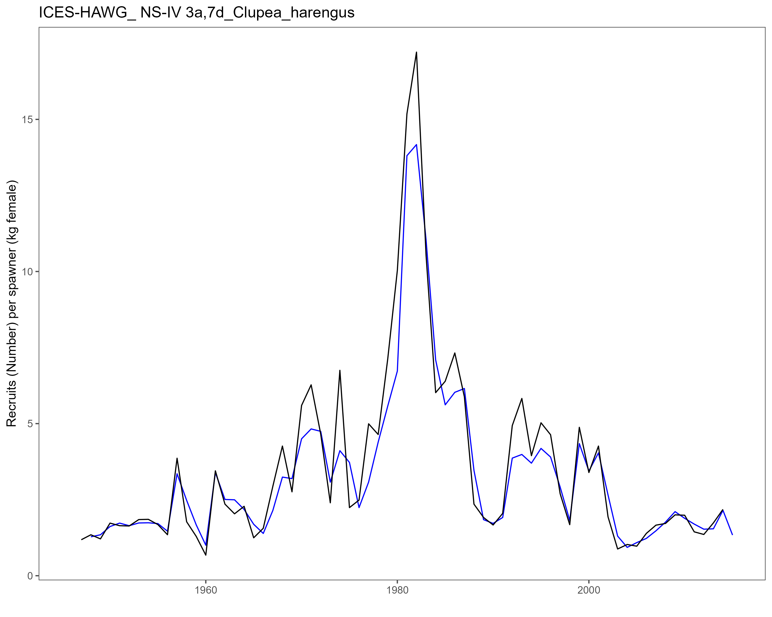
LTR Key Results
Results for 77 stocks in Atlantic and Pacific (Alaska)

Slide 10
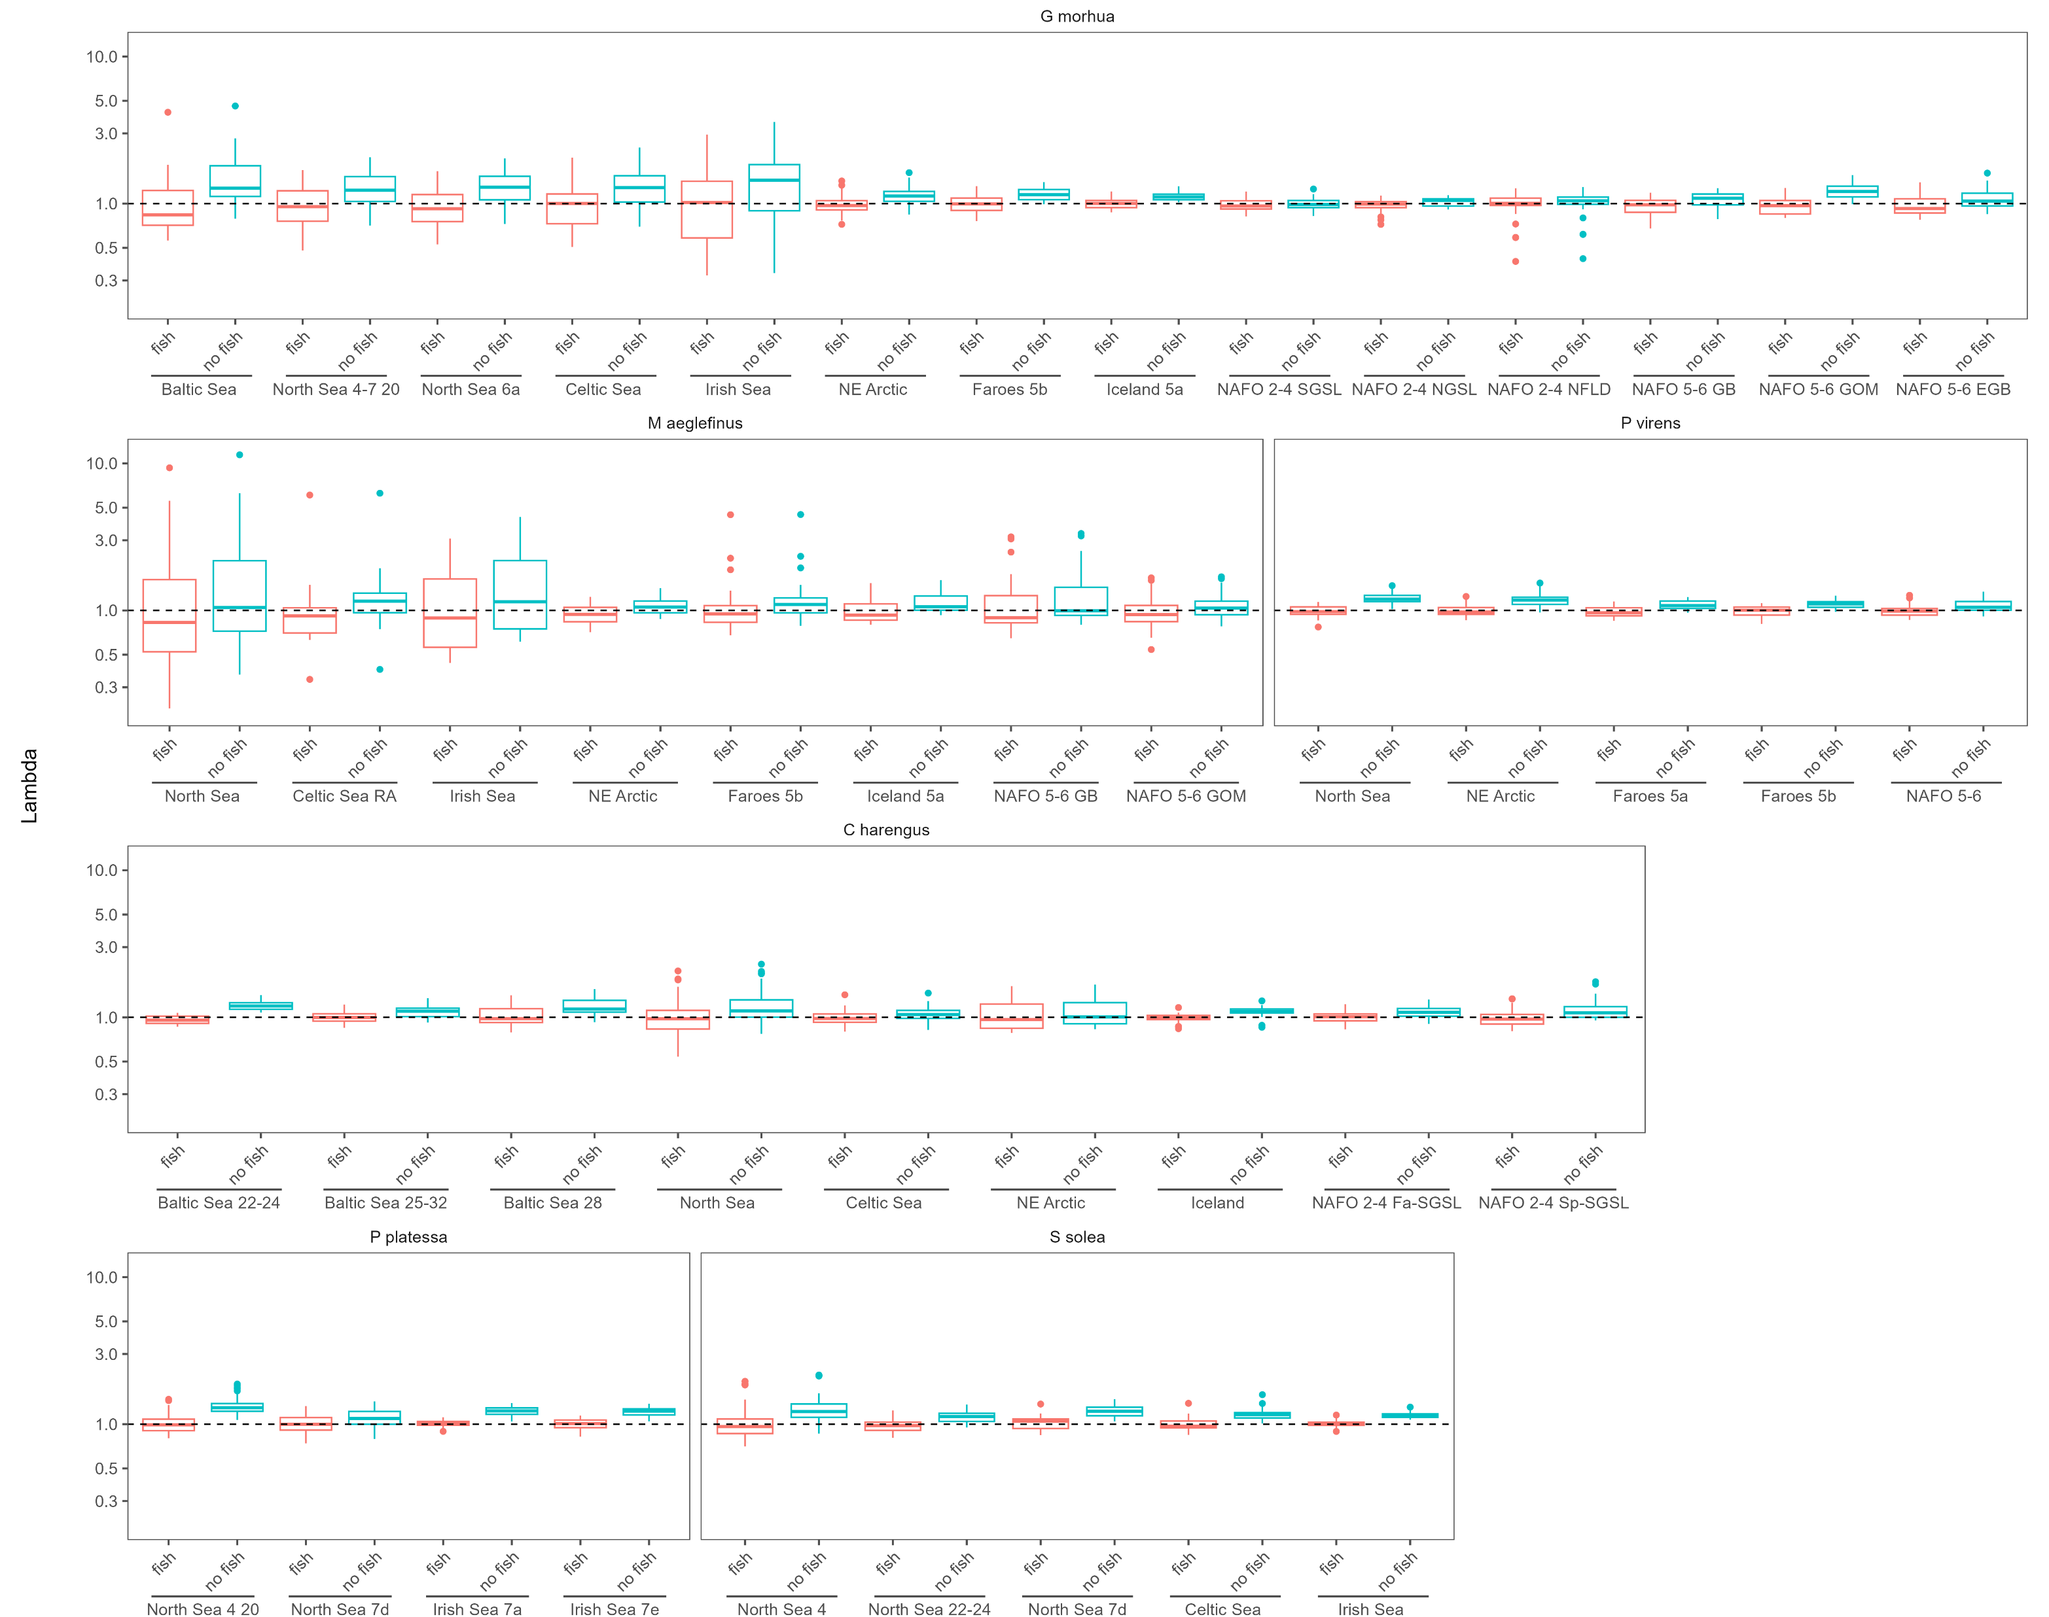
LTR Key Results
Variability matters (‘rare’ big events)
lambda

Slide 11
LTR Key Results
Productivity should not be generalized from Life History
lambda

Slide 12

LTR Key Results
Variability occurs due to dynamics at lower ‘density’
lambda

Slide 13
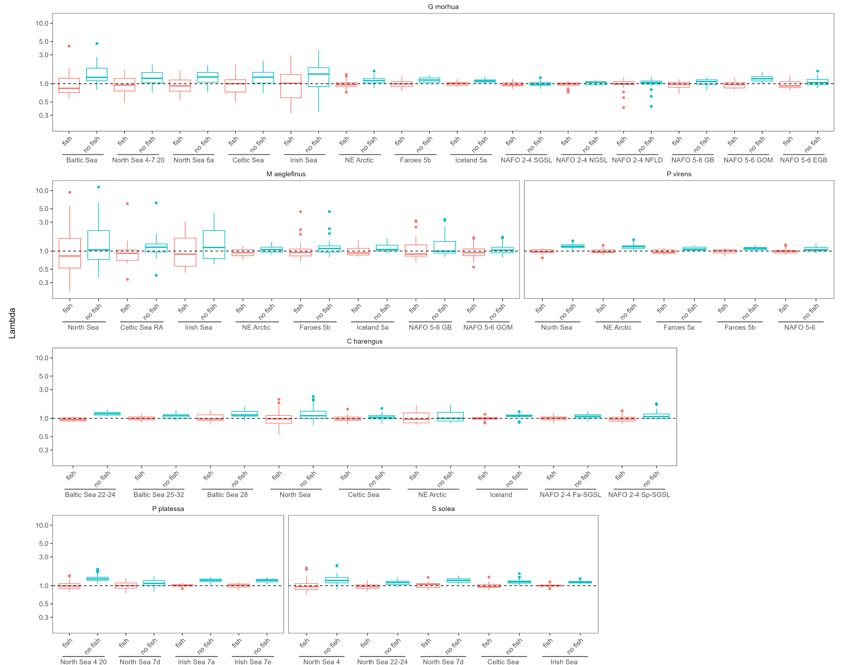
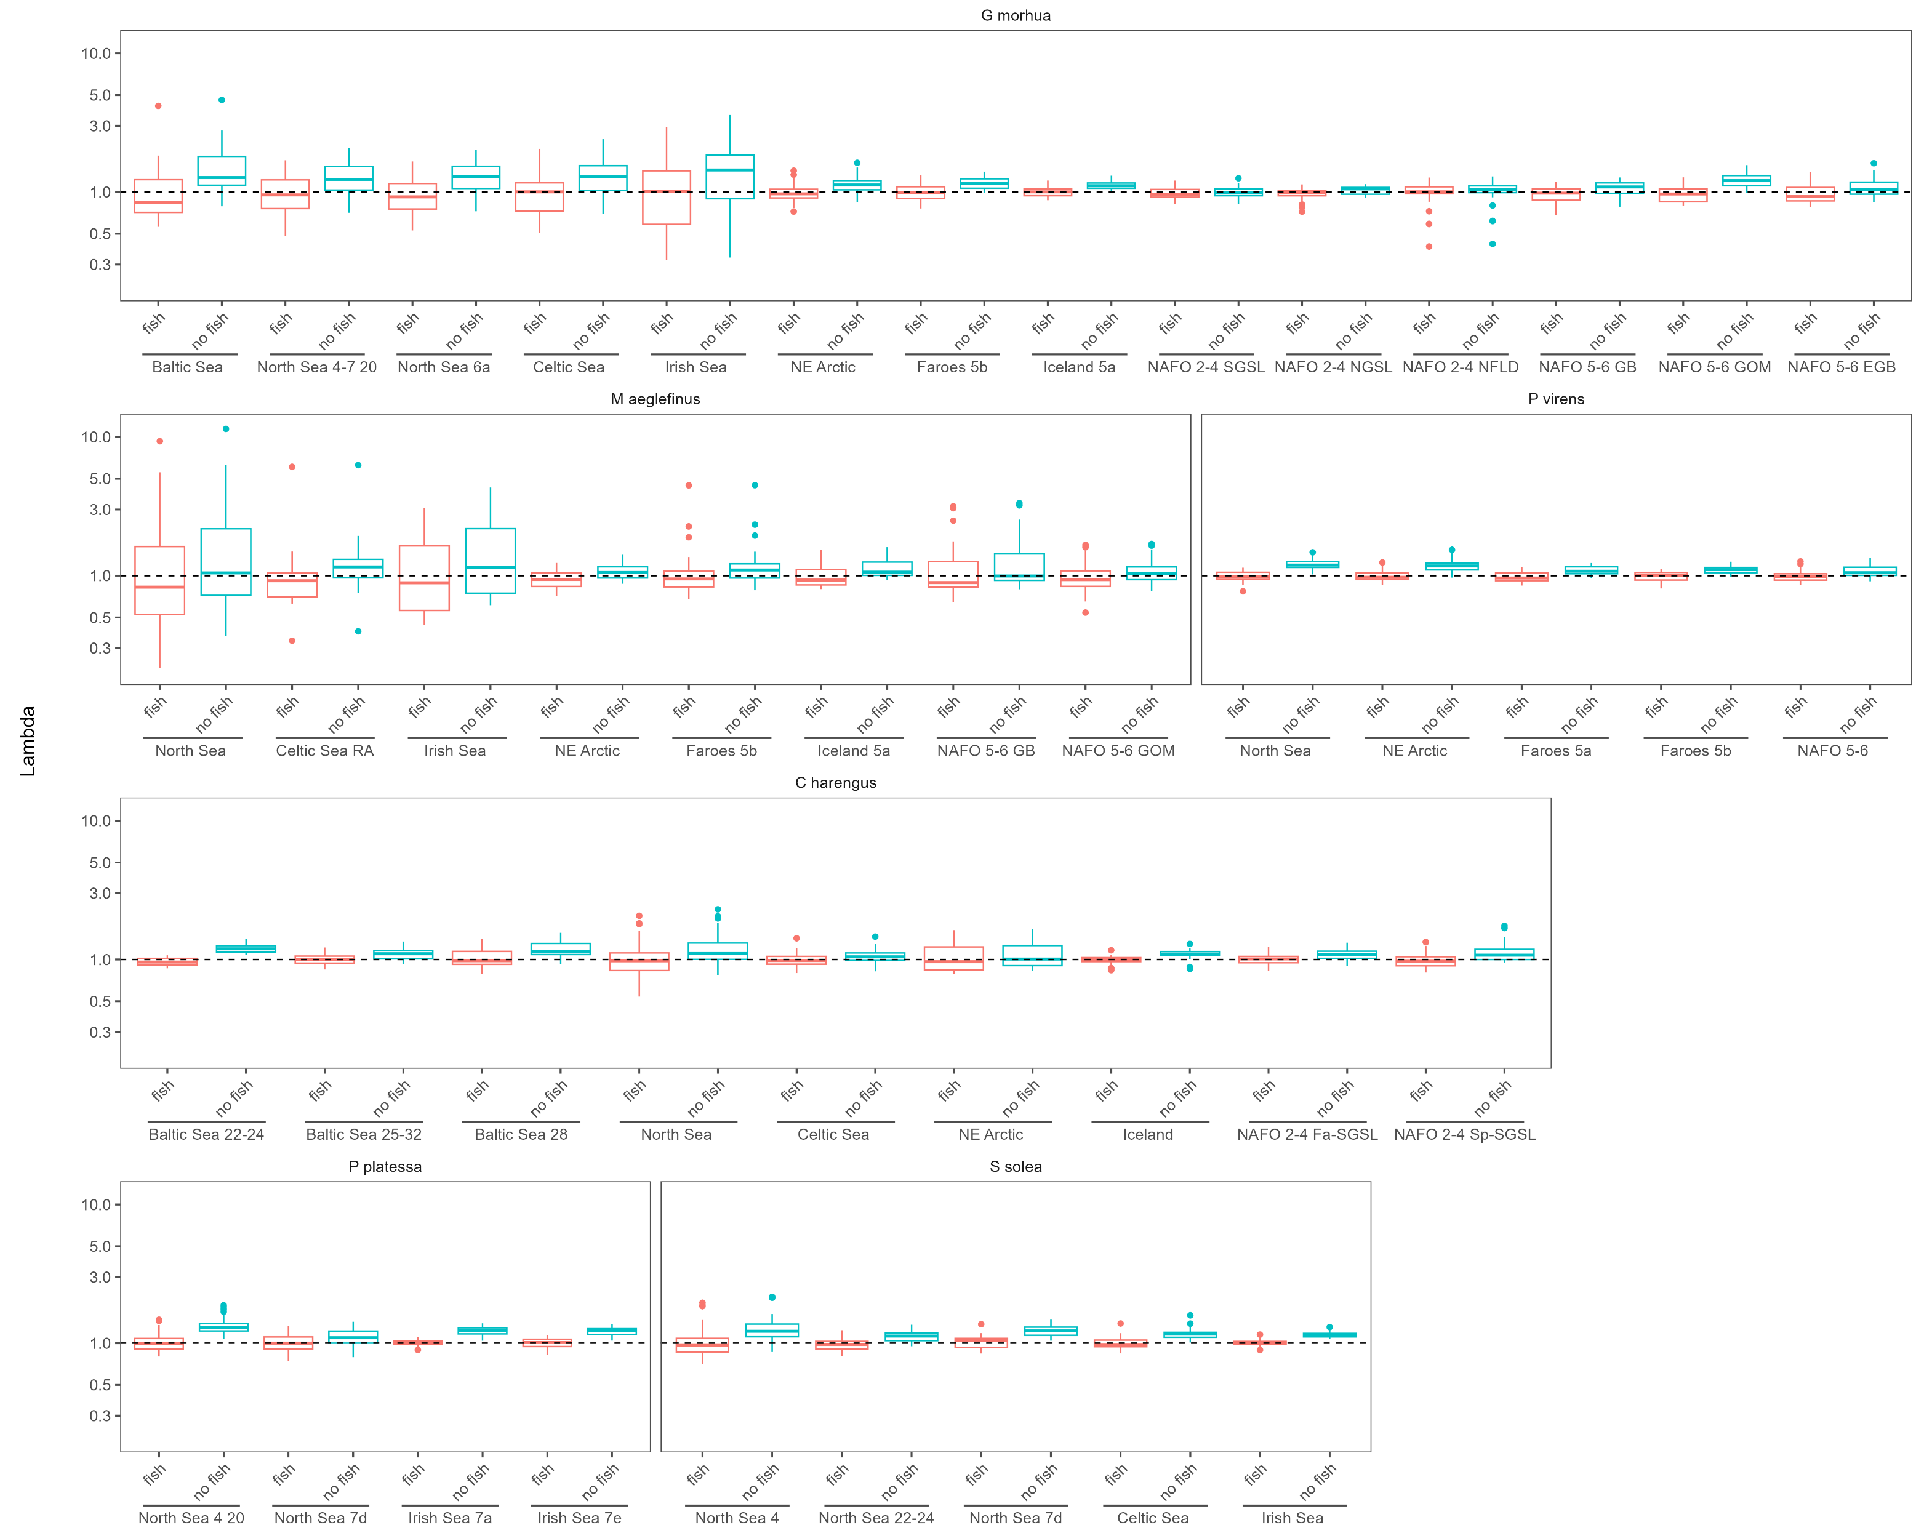
LTR Key Results
The North Sea stocks are very productive
NW Cod
NW Haddock
NW Herring
lambda
NE Cod
NE Haddock
NE Herring

Slide 14
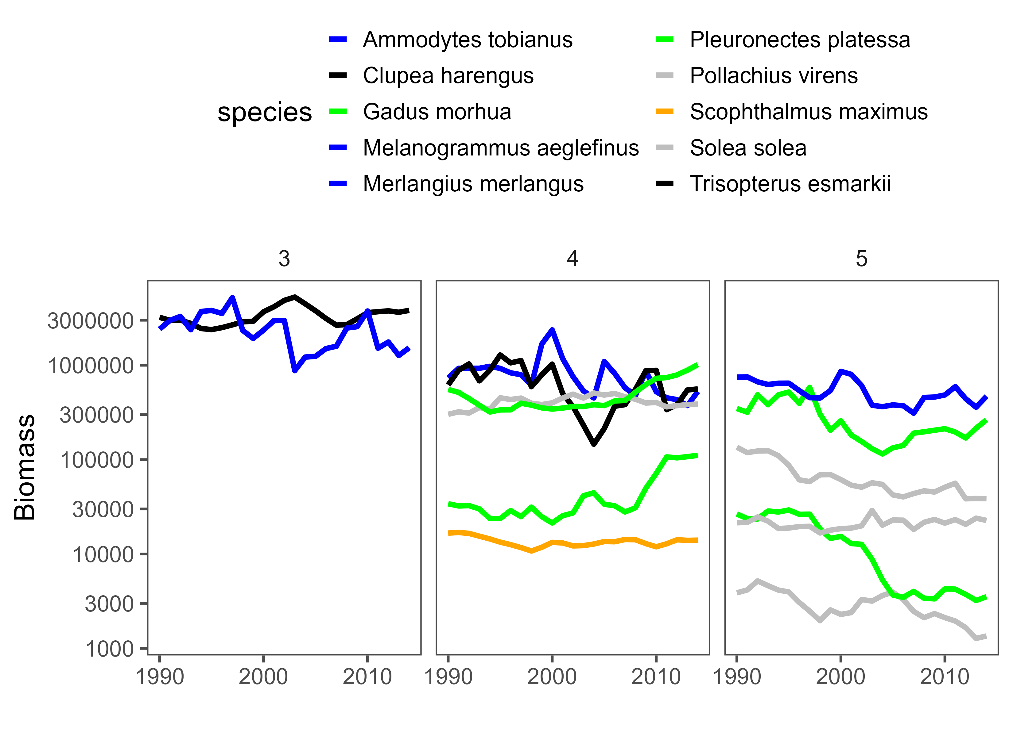
Multi-speciating LTR
Making LTR Multipsecies
Our focus in on the North Sea
Includes 14 stocks and 10 species
Based on the results of the LTR analysis

Slide 15
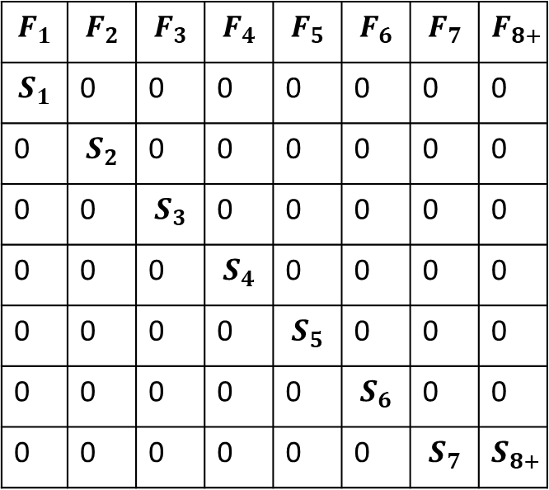
Multi-speciating LTR
Based on the results of the LTR analysis
At its foundation are the historically observed fecundity and natural mortality observations.
We assume the productivity dynamics observed in the past inform the dynamics in the future
$$F_{1}$$ | $$F_{2}$$ | $$F_{3}$$ | $$F_{4}$$ | $$F_{5}$$ | $$F_{6}$$ | $$F_{7}$$ | $$F_{8+}$$
$$S_{1}$$ | 0 | 0 | 0 | 0 | 0 | 0 | 0
0 | $$S_{2}$$ | 0 | 0 | 0 | 0 | 0 | 0
0 | 0 | $$S_{3}$$ | 0 | 0 | 0 | 0 | 0
0 | 0 | 0 | $$S_{4}$$ | 0 | 0 | 0 | 0
0 | 0 | 0 | 0 | $$S_{5}$$ | 0 | 0 | 0
0 | 0 | 0 | 0 | 0 | $$S_{6}$$ | 0 | 0
0 | 0 | 0 | 0 | 0 | 0 | $$S_{7}$$ | $$S_{8+}$$

Slide 16
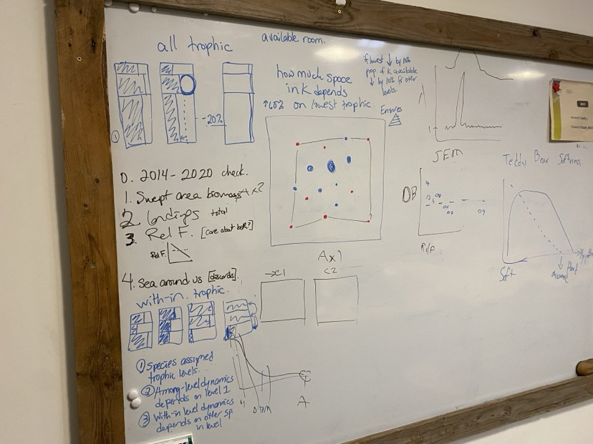
Multi-speciating LTR
We then took a trophic approach
Trophic level interactions
Occur for species within a trophic level
Occur between the trophic levels themselves

Slide 17
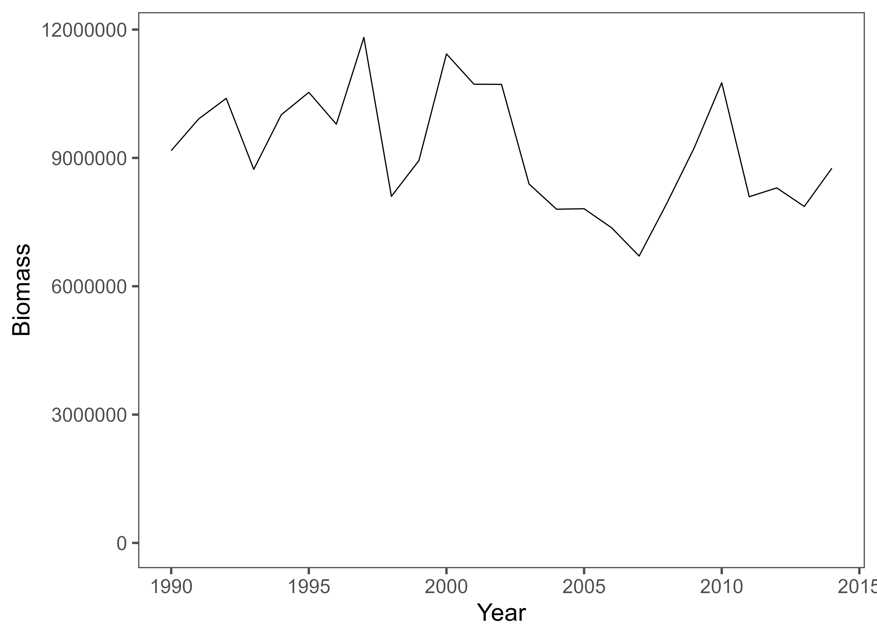
Multi-speciating LTR
We took a trophic approach
Our approach ‘assumes’ there is a carrying capacity for the ecosystem and for the trophic levels
This is again based on historically observed patterns

Slide 18
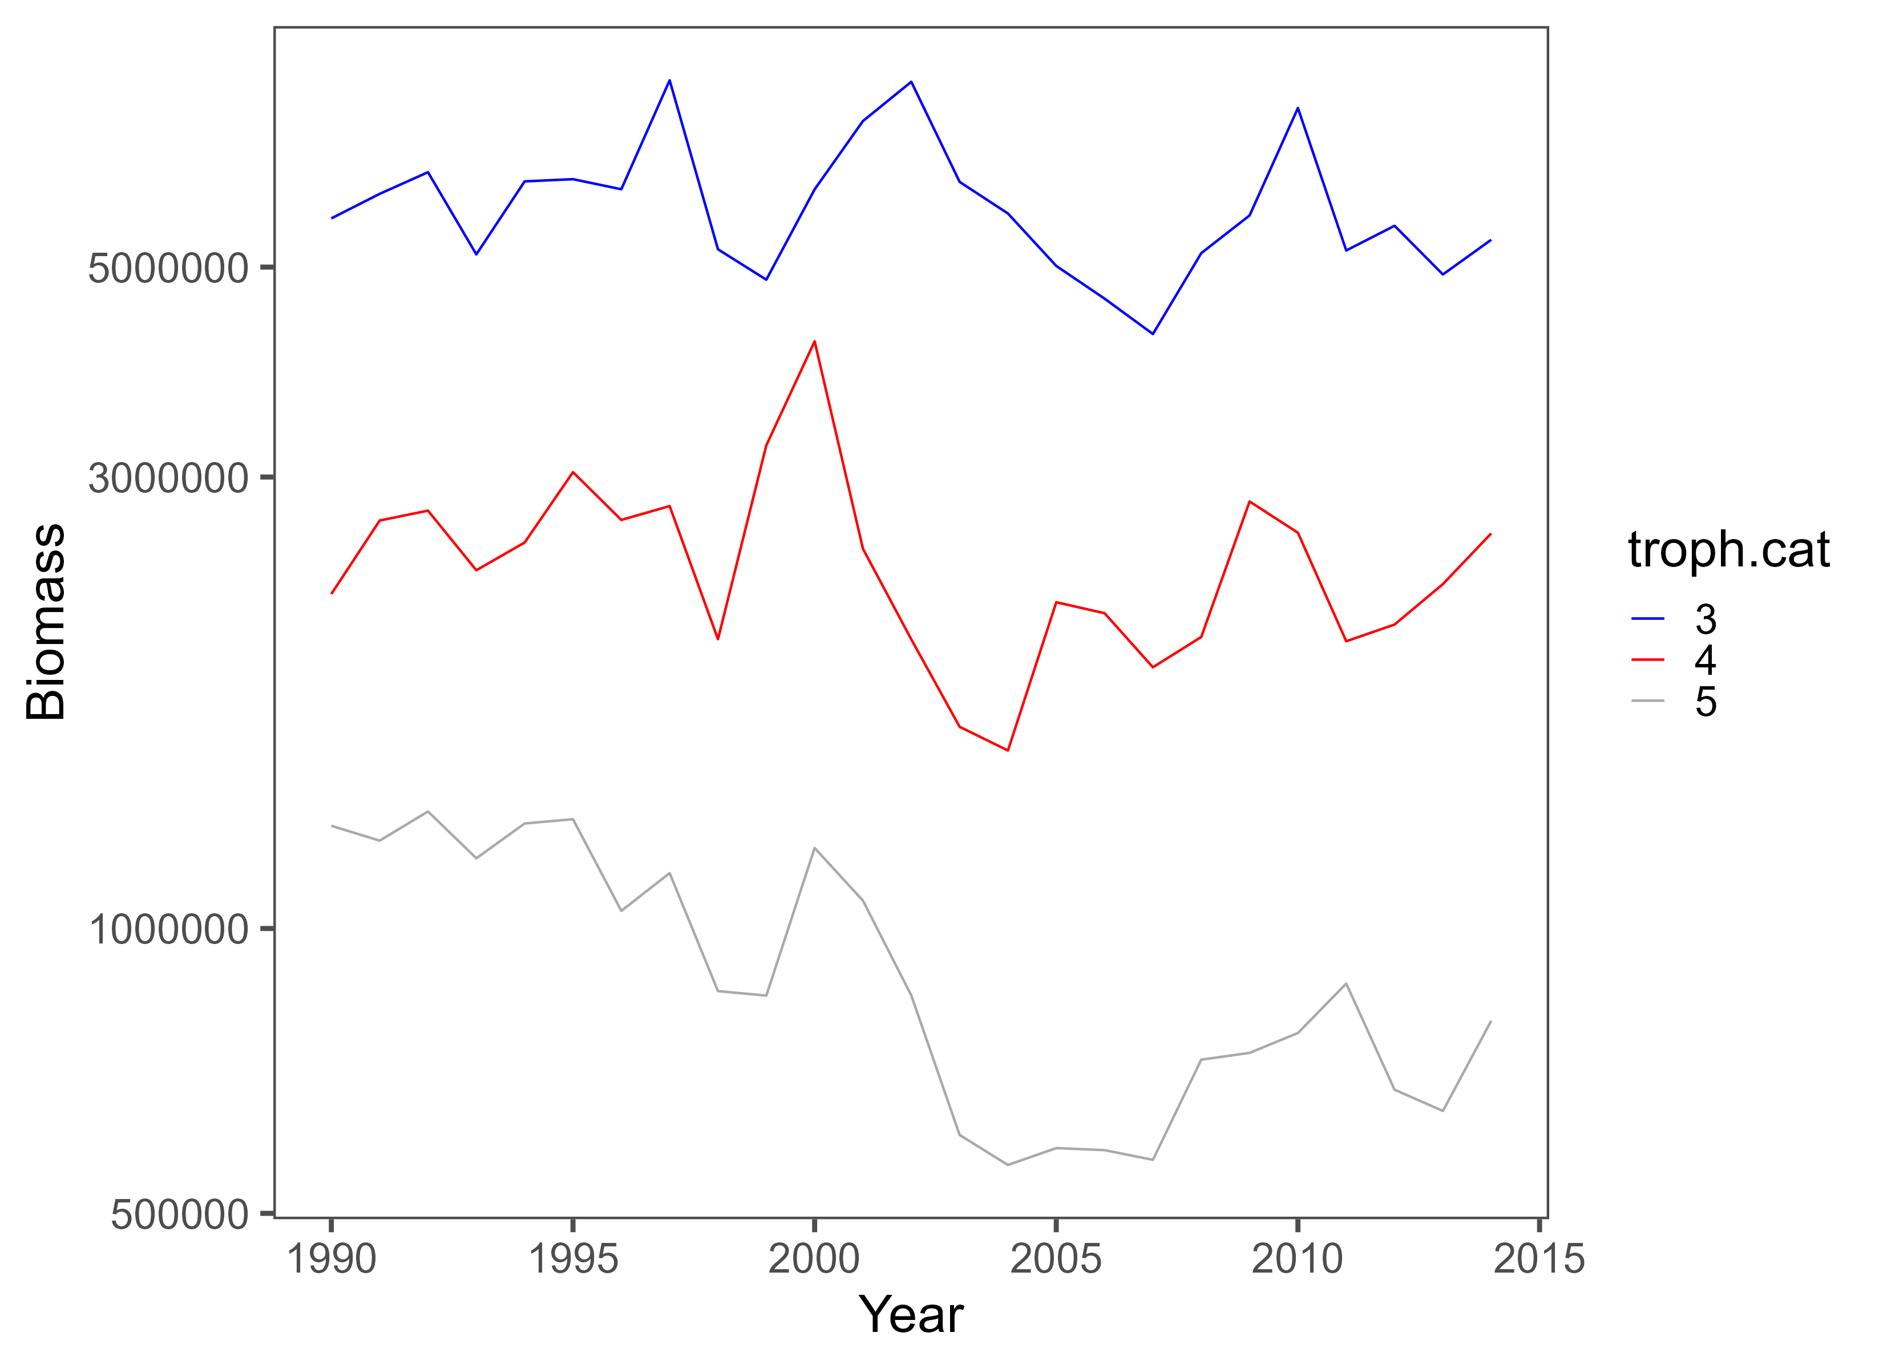
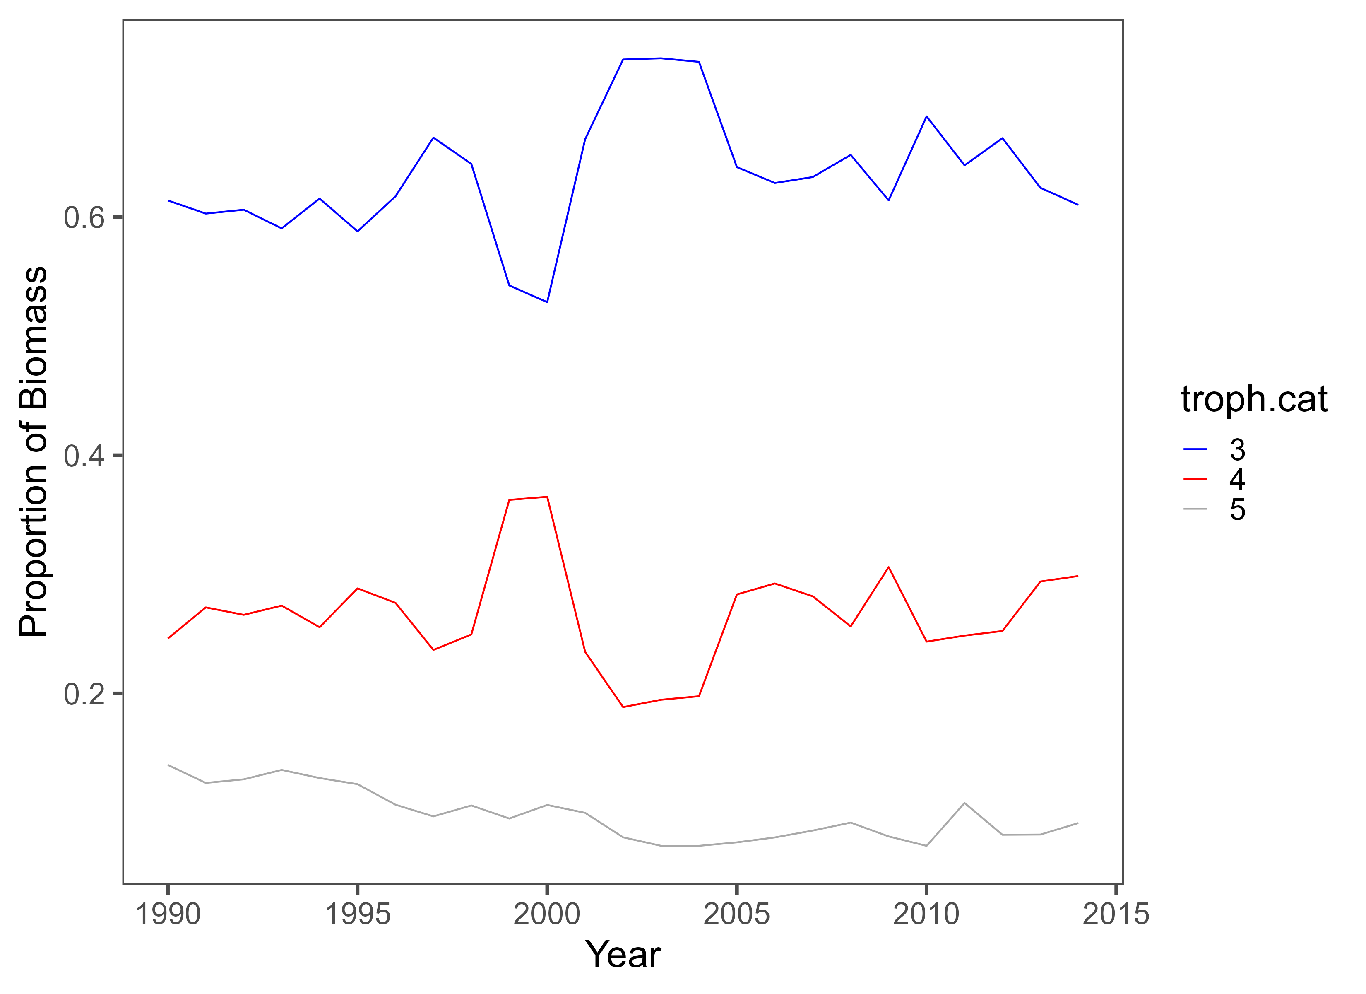
Multi-speciating LTR
We took a trophic approach
Our approach ‘assumes’ there is a carrying capacity for the ecosystem and for the trophic levels
This is again based on historically observed patterns

Slide 19
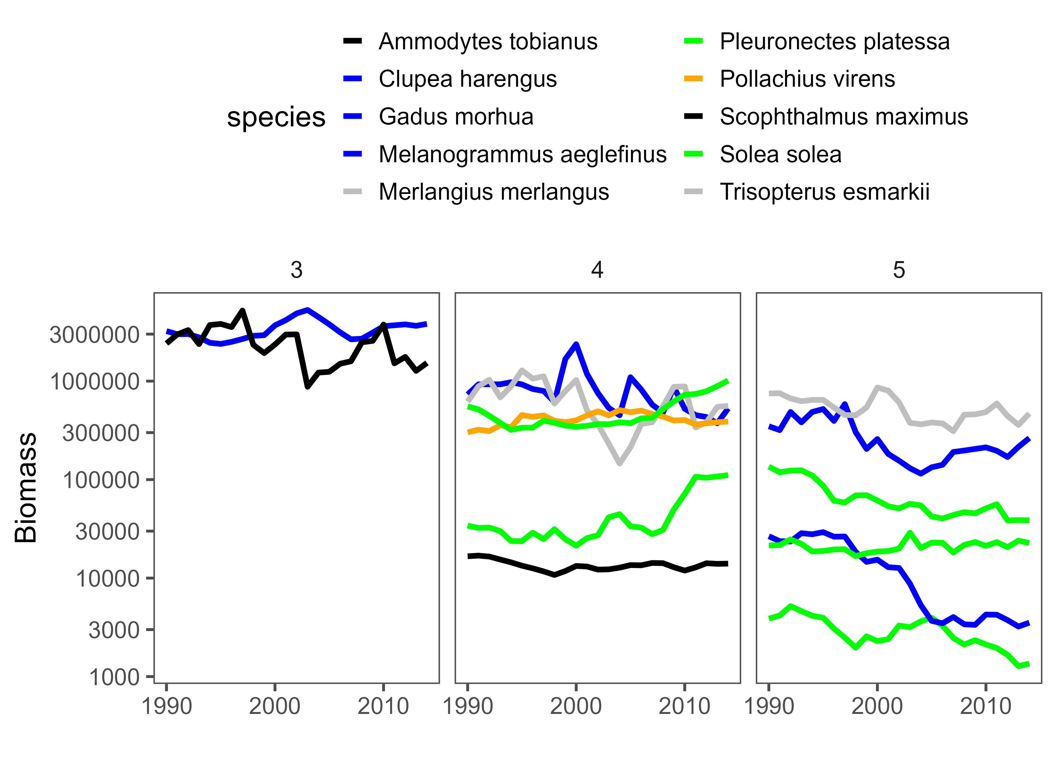
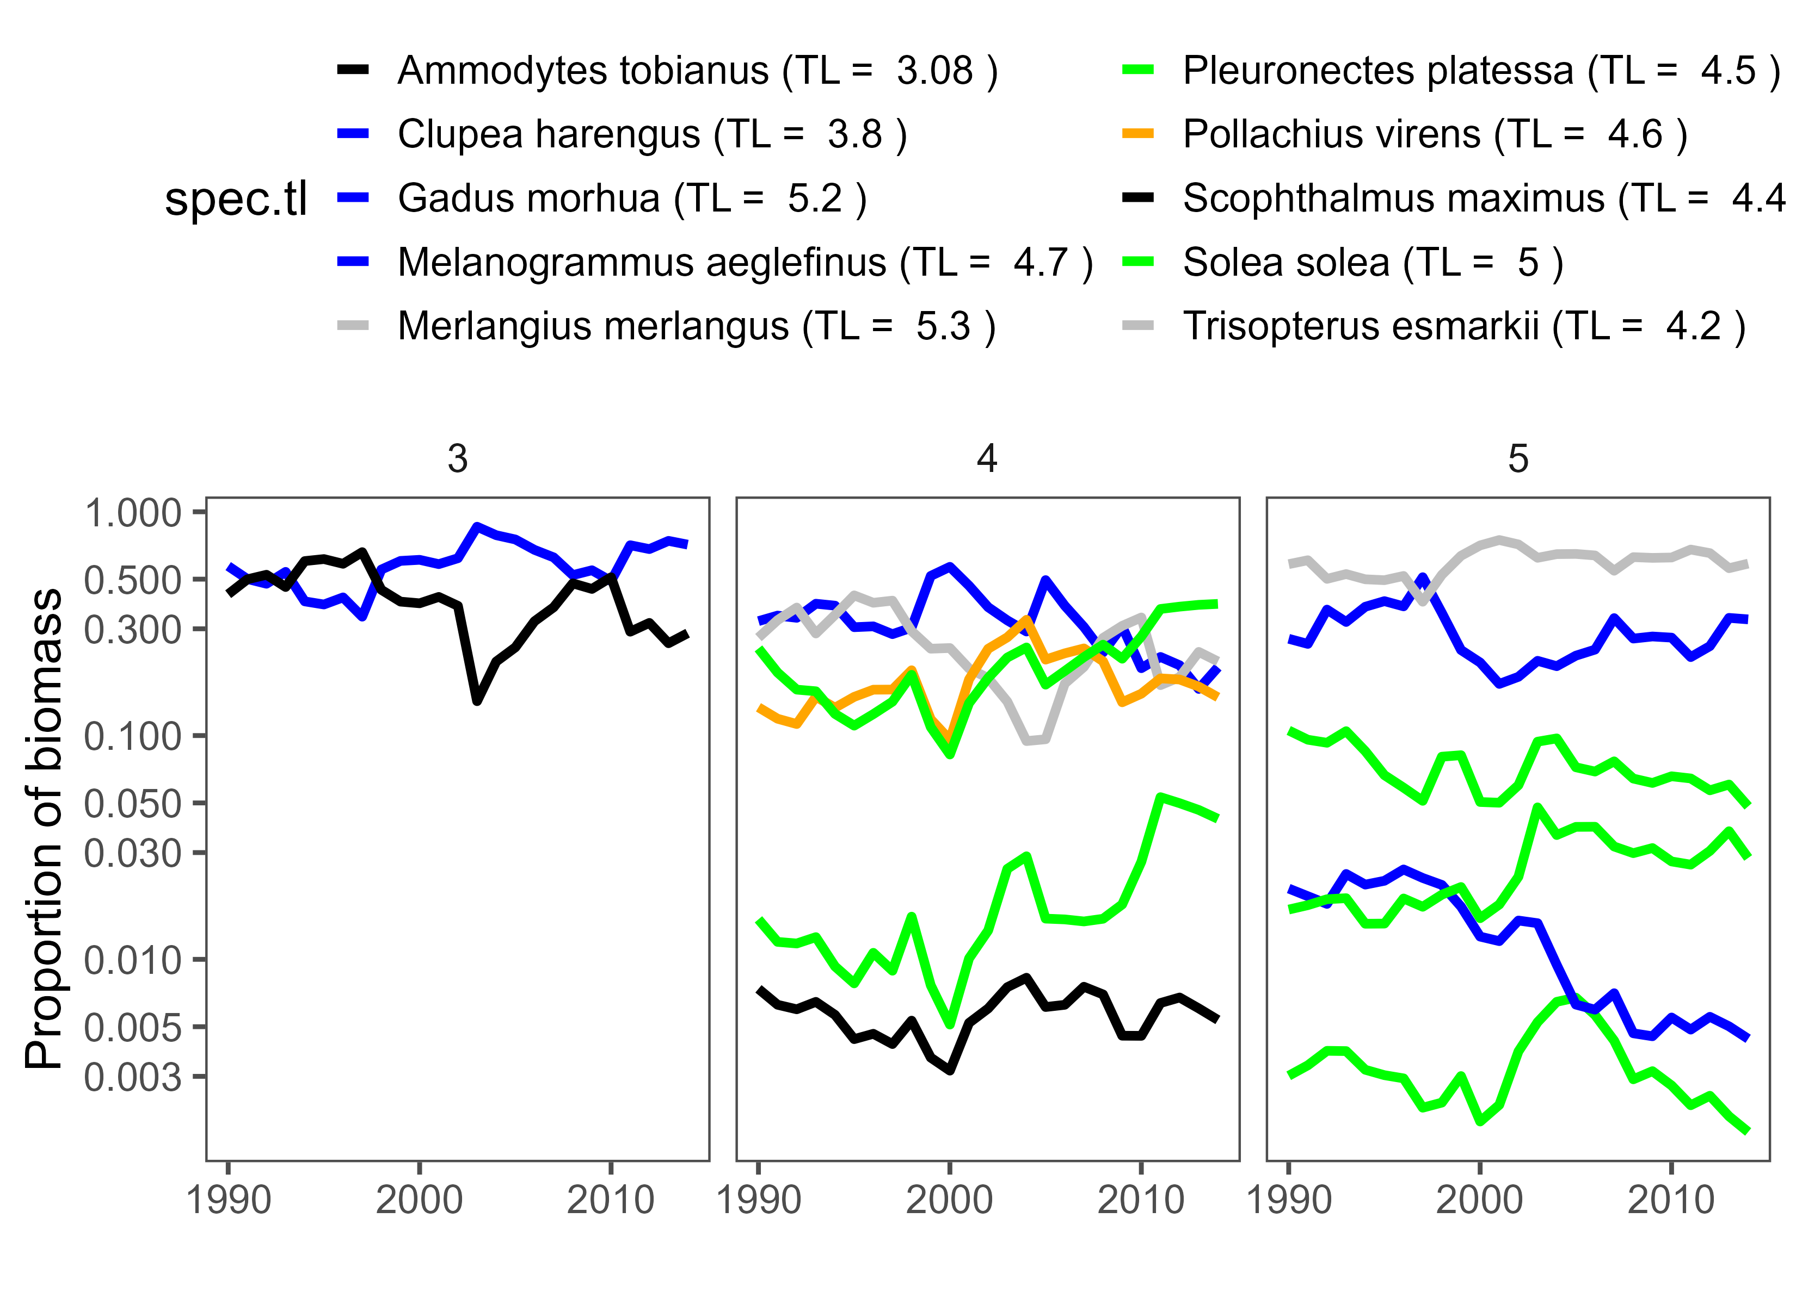
Multi-speciating LTR
We took a trophic approach
Each stock within a trophic level has its own carrying capacity
Again, these are based on historic patterns

Slide 20
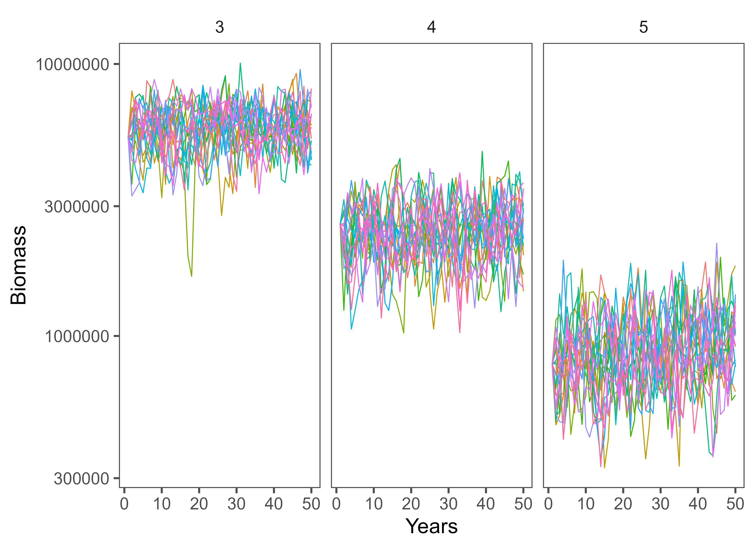
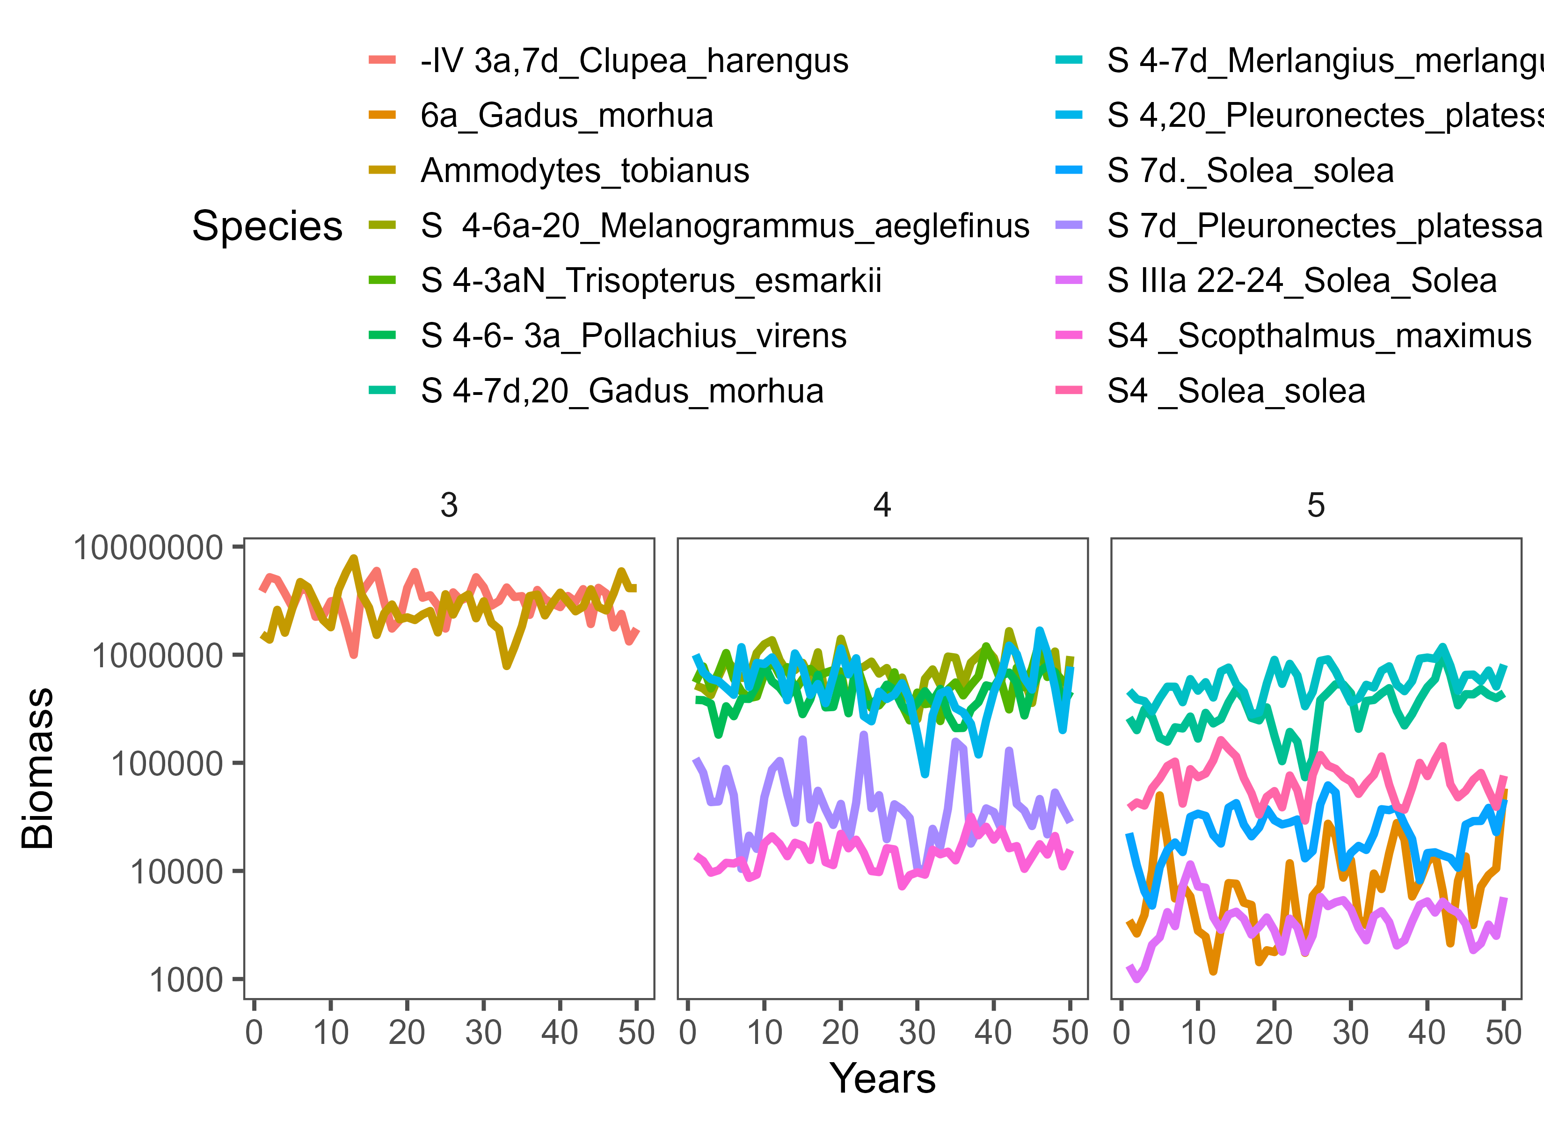
Multi-speciating LTR
We can then project Ecosystem ‘productivity scenarios’ into the future
To start with, this is based on historical observed patterns

Slide 21
K Space
Inter-species interaction based on “K-Space”
Recall each trophic level has a total carrying capacity
Each year, the species within the trophic level will have a total biomass
If total biomass < K, there is ‘productivity available’ within the tropic level – this is K Space!
Available “Carrying
Capacity”
Total
Trophic
Level
K
Total
Observed
Trophic
level
Biomass
“K Space” divided among stocks

Slide 22
K-Space
Recalculated each year based on dynamics from previous year
Division based on historic proportions
Can also reduce K
“K Space” divided among stocks

Slide 23
Does this harebrained idea work?
If a stock is above it’s “adjusted K” then population growth is generally negative
In line with what we have observed

Slide 24
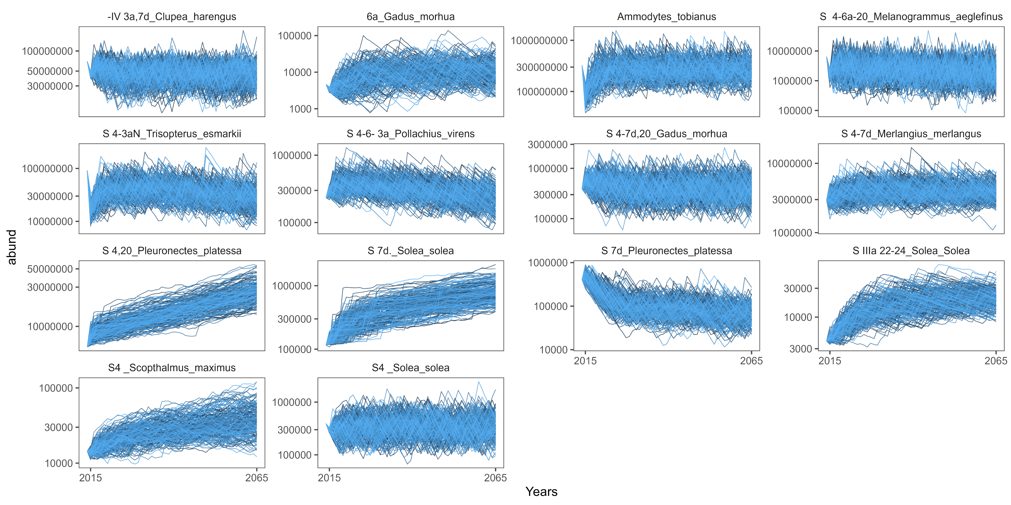
Does this harebrained idea work?
Initial results are hopeful!
This is with no fishing mortality

Slide 25
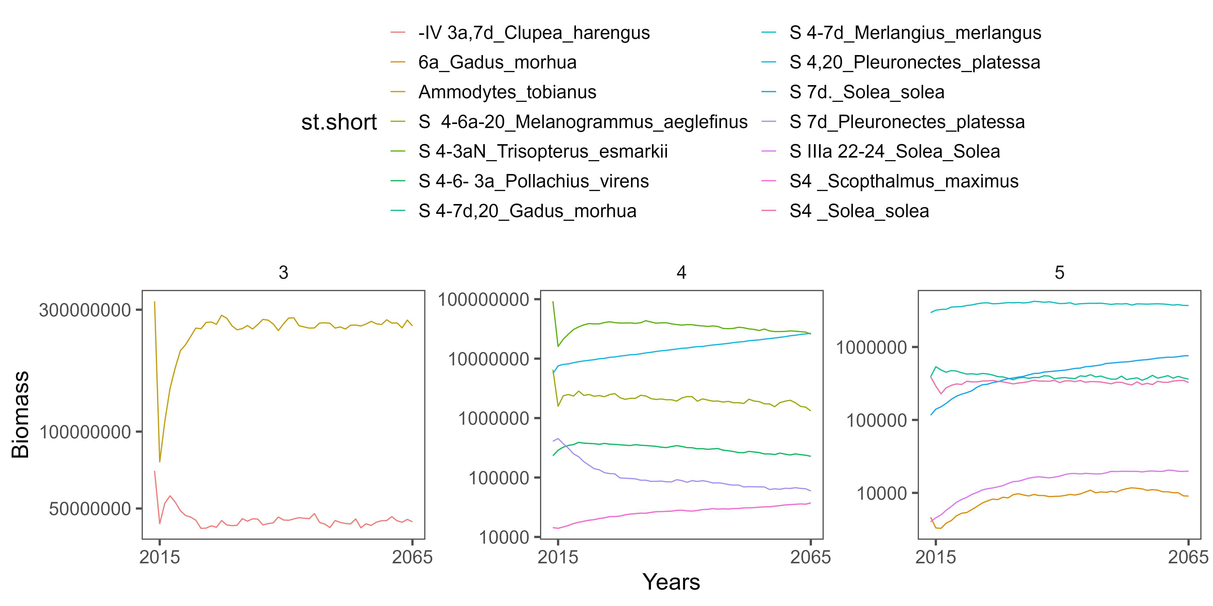
Does this harebrained idea work?
Initial results are hopeful!
This is with no fishing mortality

Slide 26
What now?
Code check and clean up
Document and discuss hidden decisions
Test response to fishing scenarios
Automate code for fishing scenarios
Integrate into MSA (Matt’s Shiny App)
New student, new data, and new ecosystem
Think about climate scenarios someday

Slide 27
Planning
Finalize and submit the initial Single Species model
Finalize code and develop a draft of the Multi-species Model paper
Explore the potential to integrate non-assessed species into MSM
Begin integration of MSM with MSA for North Sea

